Slide 1
Converting terminating decimals to fractions
Comparing and ordering fractions and decimals (positive and negative)

Slide 2
how to use Oak lessons

Slide 3
I can appreciate that any terminating decimal can be written as a fraction with a denominator of the form 10^{n}.

Slide 4
A terminating decimal is one that has a finite number of digits after the decimal point.
Example
Example
Non example
Non example

Slide 5

Converting terminating decimals to fractions
Fractions less than 1
Fractions greater than 1
Writing the denominator in exponential form

Slide 6





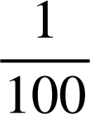
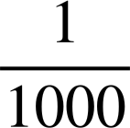
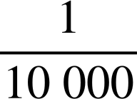
Fractions less than 1
Given terminating decimals have a finite number of digits after the decimal point, we can use a place value chart to help us identify the decimal as a fraction.

Slide 7
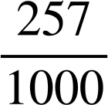
Fractions less than 1
A decimal is a number that has parts that are not whole. The place value chart splits whole numbers into tenths, hundredths, thousandths, and so on.
0
2
5
7
Write the decimal 0.257 as a fraction

Slide 8
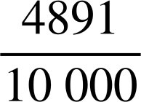
Fractions less than 1
What do you think 0.4891 is as a fraction?
You can use a place value chart if it helps.
0
4
8
9
1
This decimal can be written as

Slide 9
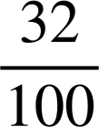
Fractions less than 1
What do you think 0.32 is as a fraction?
You can use a place value chart if it helps.
0
3
2
This decimal can be written as

Slide 10
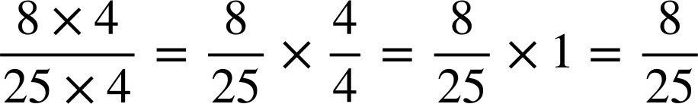
Fractions less than 1
What do you think 0.32 is as a fraction?
You can use a place value chart if it helps.
0
3
2
This can be simplified further

Slide 11
Fractions less than 1
A terminating decimal can be written as a fraction with a power of 10 denominator.
The number of decimal places will help you select an appropriate power of 10 for the fraction which can then be simplified.

Slide 12
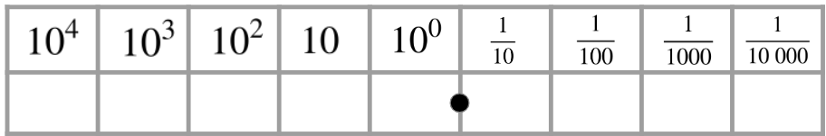
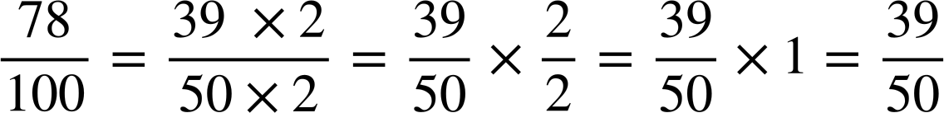
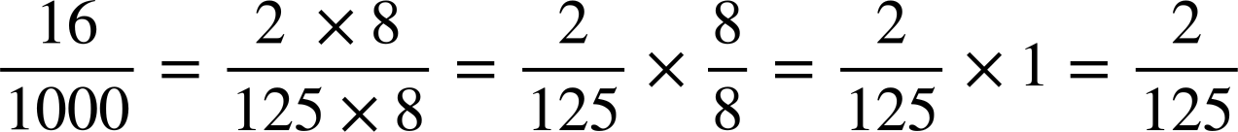
Fractions less than 1
Convert the following terminating decimals to simplified fractions. You can use a place value chart to help.
Convert the following terminating decimals to simplified fractions. You can use a place value chart to help.
0
0
6
0
7
1
8
0.78
0.016

Slide 13
Fractions less than 1
Convert the following into simplified fractions:
0.65
b) 0.34
c) 0.12
d) 0.542
e) 0.864
f) 0.1248

Slide 14
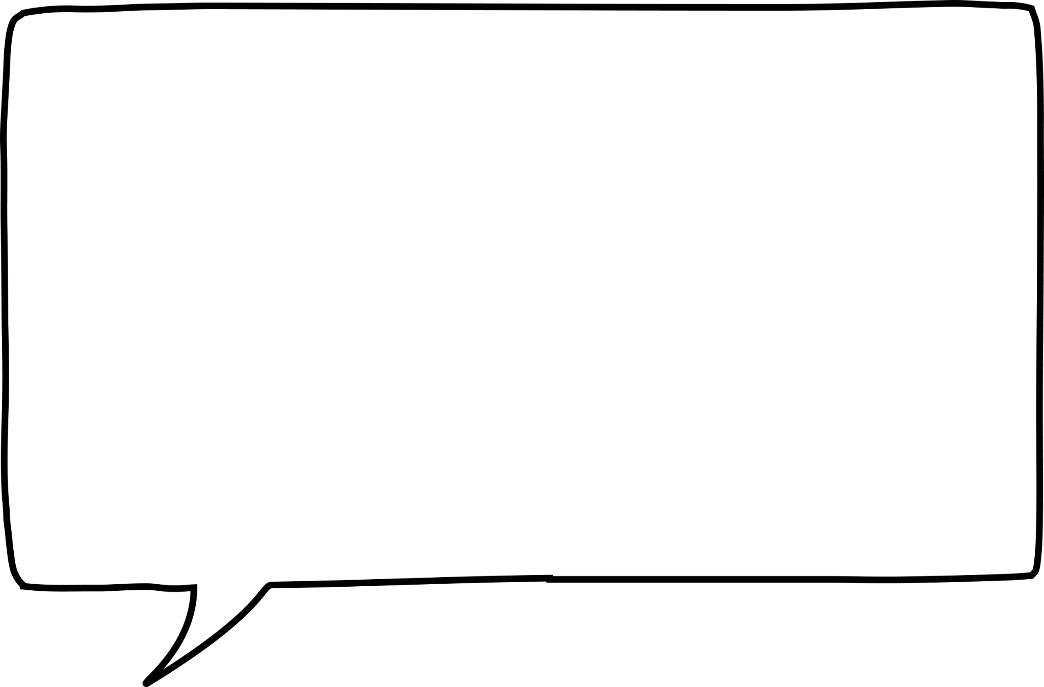
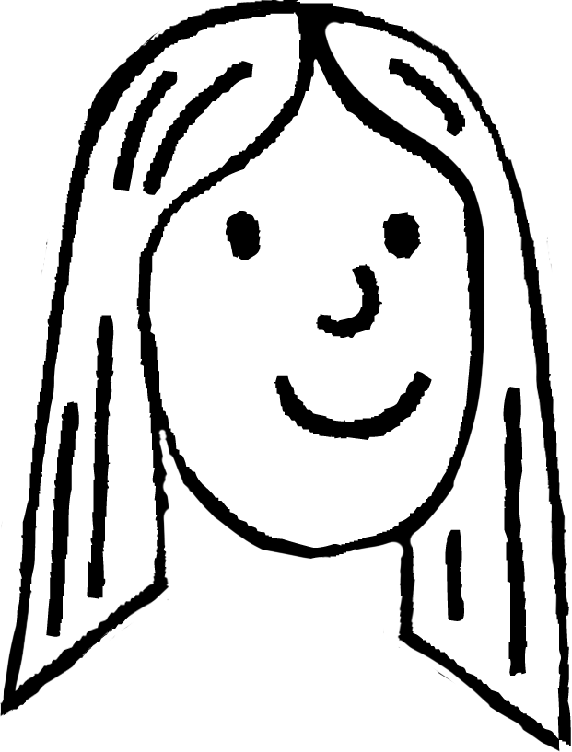
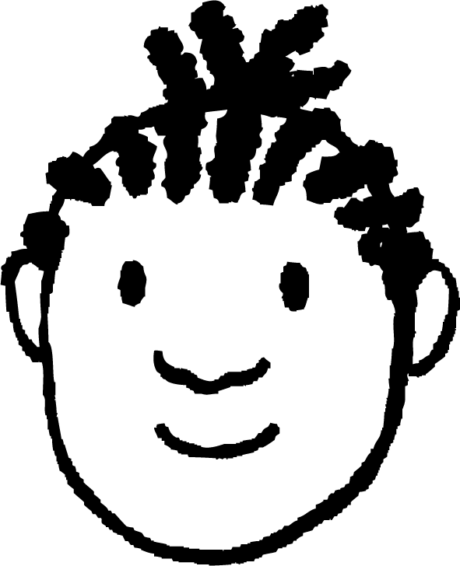
Fractions less than 1
2) Laura and Jacob are given 0.56 and 0.560 to convert into a fraction.
Who is correct? Work out the fractional equivalent to the decimal(s).
The answers will be different as 0.56 is two decimals places and 0.560 is 3 decimal places
It is the same decimal so it will be the same fraction
Laura says
Jacob says

Slide 15
Fractions less than 1
3a) Write the fraction which is halfway between 0.96 and 0.88
0.88
0.96
3b) Write the fraction which is a quarter of the way between 0.42 and 0.84
0.42
0.84

Slide 16
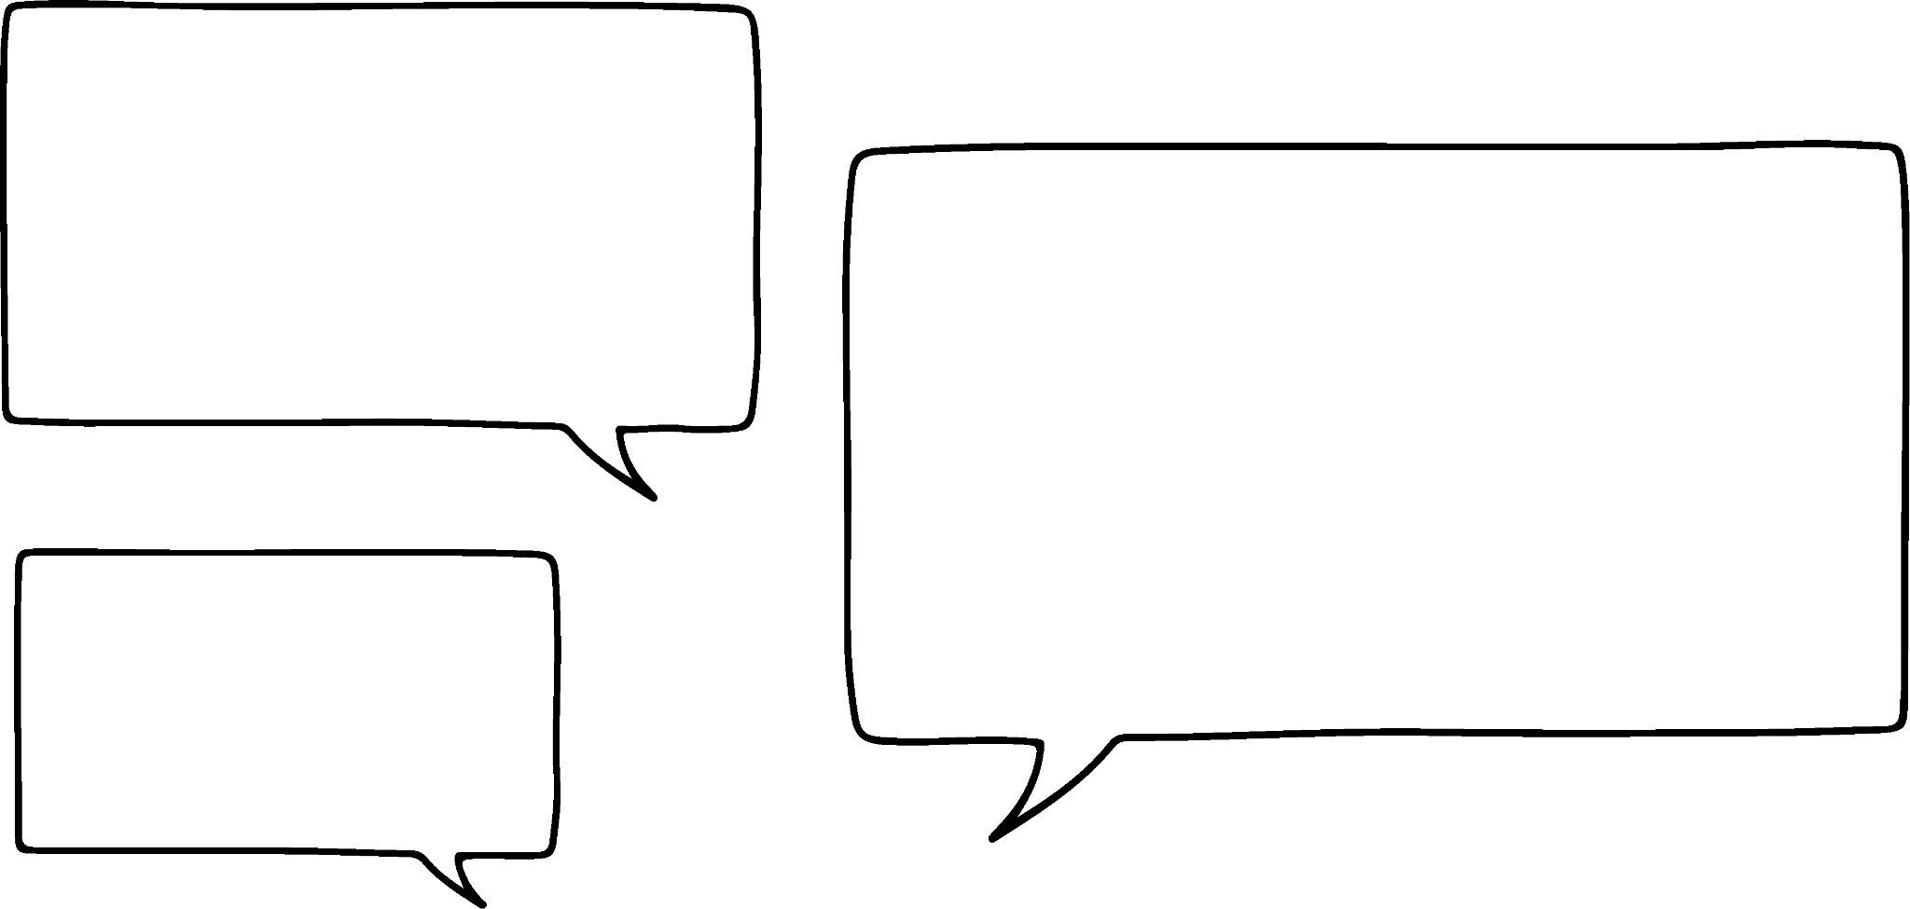
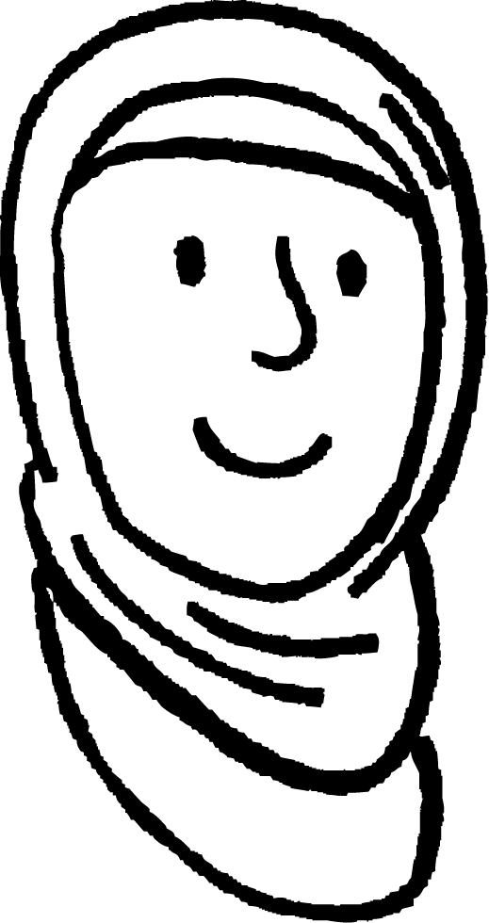
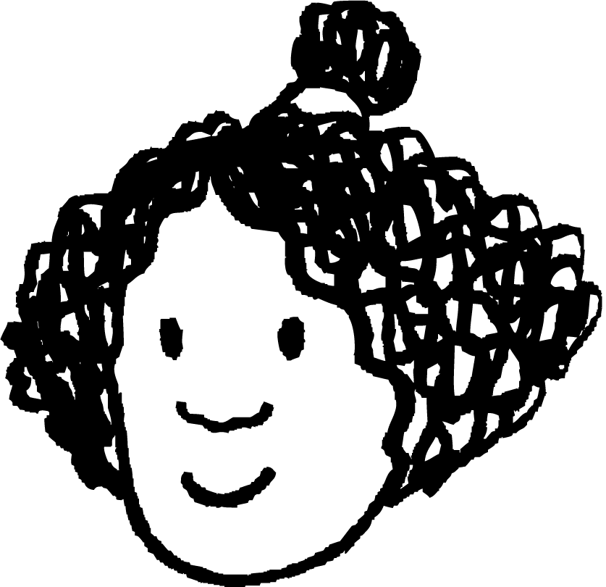
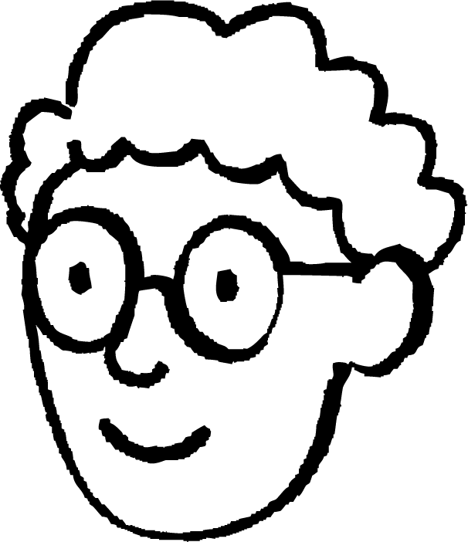
Fractions less than 1
3c)
0.12
0.36
Three students created their own method to find the middle fraction.
Add 0.36 with 0.12, then halve the answer. Then find the fraction of the decimal.
I converted 0.12 and 0.36 into fractions. You can see the middle easily.
Work out the difference between 0.36 and 0.12, then halve it and add it to 0.12. Convert this to a fraction.
Aisha
Izzy
Do all three methods work? Explain.
Alex

Slide 17
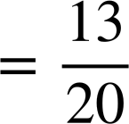
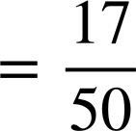
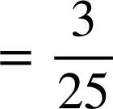
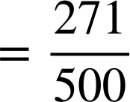
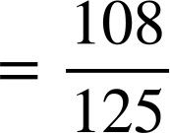
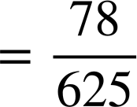
Fractions less than 1
Convert the following into simplified fractions:
0.65
b) 0.34
c) 0.12
d) 0.542
e) 0.864
f) 0.1248

Slide 18

Fractions less than 1
2) Laura and Jacob are given 0.56 and 0.560 to convert into a fraction.
Who is correct? Work out the fractional equivalent to the decimal(s).
The answers will be different as 0.56 is two decimals places and 0.560 is 3 decimal places
It is the same decimal so it will be the same fraction
Laura says
Jacob says
Both 0.56 and 0.560 are equal. They both are equivalent to

Slide 19


Fractions less than 1
3a) Write the fraction which is halfway between 0.96 and 0.88
0.88
0.96
3b) Write the fraction which is a quarter of the way between 0.42 and 0.84
0.42
0.84

Slide 20
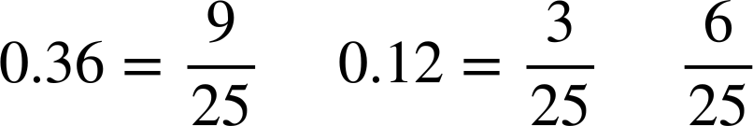
Fractions less than 1
3c)
Three students created their own method to find the middle fraction.
0.12
0.36
I converted 0.12 and 0.36 into fractions. You can see the middle easily.
and so the middle fraction is
Izzy

Slide 21
Fractions less than 1
3c)
Three students created their own method to find the middle fraction.
0.12
0.36
Add 0.36 with 0.12, then halve the answer. Then find the fraction of the decimal.
0.36 + 0.12 = 0.48 then 0.48 ÷ 2 = 0.24 =
Aisha

Slide 22
Fractions less than 1
3c)
Three students created their own method to find the middle fraction.
0.12
0.36
Work out the difference between 0.36 and 0.12, then halve it and add it to 0.12. Convert this to a fraction.
Alex
0.36 - 0.12 = 0.24 then 0.24 ÷ 2 = 0.12 then 0.12 + 0.12 = 0.24 =

Slide 23
Converting terminating decimals to fractions
Fractions less than 1
Fractions greater than 1
Writing the denominator in exponential form

Slide 24
Fractions greater than 1
Now we know how to convert decimals which are less than 1 into a fraction, we need to use these skills with decimals greater than 1.
Example
Convert 3.14 into a fraction
Do you think you can see how to do this?

Slide 25
Fractions greater than 1
Now we know how to convert decimals which are less than 1 into a fraction, we need to use these skills with decimals greater than 1.
Example
Convert 3.14 into a fraction
You can partition the decimal from the integer.
3
0.14

Slide 26
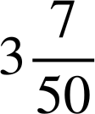
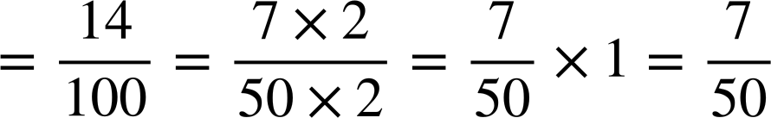
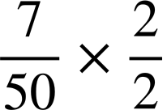
Fractions greater than 1
Now we know how to convert decimals which are less than 1 into a fraction, we need to use these skills with decimals greater than 1.
Then use your skills to convert 0.14 into a fraction.
Example
Convert 3.14 into a fraction
This means 3.14 =
3
0.14

Slide 27
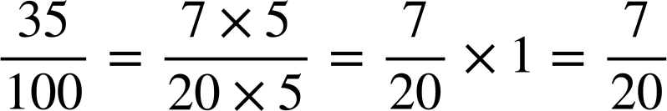
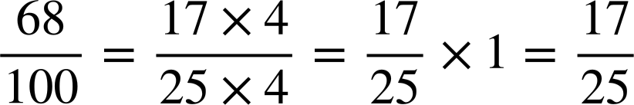
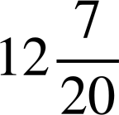
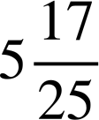
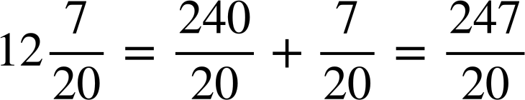
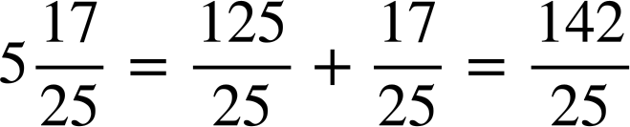
Fractions greater than 1
Convert 12.35 into
A mixed number
An improper fraction
Convert 5.68 into
A mixed number
An improper fraction
12.35 = 12 + 0.35
5.68 = 5 + 0.68
0.35 =
0.68 =
12.35 =
5.68 =

Slide 28
Fractions greater than 1
Convert the following decimals into mixed numbers and improper fractions.
Decimal | Mixed number | Improper fraction
2.45
8.125
8.288
9.72

Slide 29
Fractions greater than 1
2)
𝝅 is a special symbol and represents the non-terminating decimal 3.141592654…
There is no fractional equivalent to the exact value of 𝝅.
Work out the mixed number equivalent to:
3.141
3.1415
3.141592

Slide 30
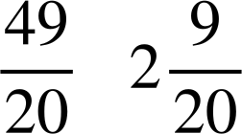
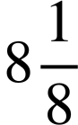

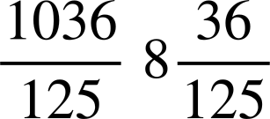
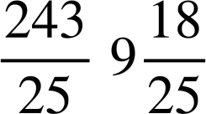
Fractions greater than 1
Convert the following decimals into mixed numbers and improper fractions.
Decimal | Mixed number | Improper fraction
2.45
8.125
8.288
9.72

Slide 31
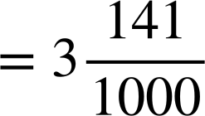
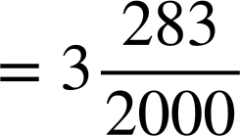

Fractions greater than 1
𝝅 is a special symbol and represents the non-terminating decimal 3.141592654…
2)
There is no fractional equivalent to the exact value of 𝝅.
Work out the mixed number equivalent to:
3.141
3.1415
3.141592

Slide 32
Converting terminating decimals to fractions
Fractions less than 1
Fractions greater than 1
Writing the denominator in exponential form

Slide 33
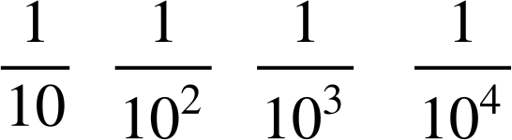
Writing the denominator in exponential form
We can also write the terminating decimal as a fraction where the denominator is given in exponential form.
A place value chart is useful here in showing how we write the denominator in exponential form.

Slide 34
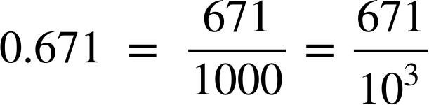
Writing the denominator in exponential form
What do you think the decimal 0.671 is as a fraction where the denominator is in exponential form?
0
6
7
1

Slide 35
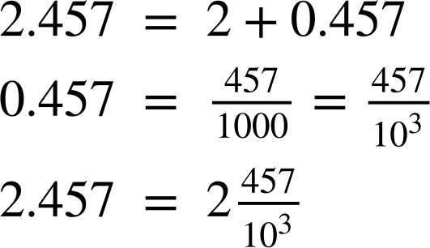
Writing the denominator in exponential form
Write the decimal 2.457 as a fraction where the denominator is in exponential form.
You can use a place value chart if it helps.
2
4
5
7

Slide 36
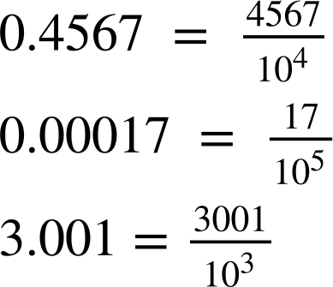
Writing the denominator in exponential form
1) Work out the power of the exponent.
a)
b)
c)

Slide 37
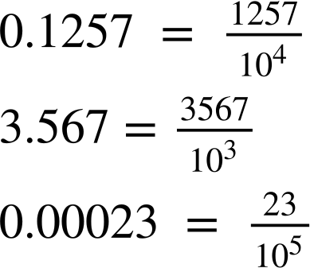
Writing the denominator in exponential form
2) Write the following decimals as a fraction where the denominator is in exponential form.
b)
c)
a)

Slide 38
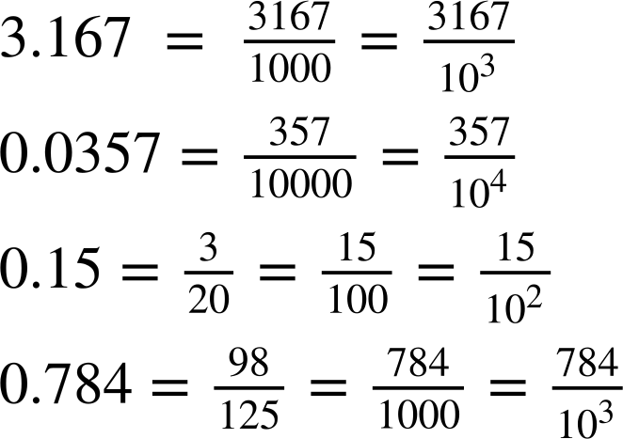
Writing the denominator in exponential form
3) Fill in the gaps.
a)
b)
c)
d)

Slide 39
Writing the denominator in exponential form
1) Work out the power of the exponent.
a)
b)
c)

Slide 40
Writing the denominator in exponential form
2) Write the following decimals as a fraction where the denominator is in exponential form.
b)
c)
a)

Slide 41
Writing the denominator in exponential form
3) Fill in the gaps.
a)
b)
c)
d)

Slide 42
Converting terminating decimals to fractions
A terminating decimal is one that has a finite number of digits after the decimal point.
A terminating decimal can be written as a fraction with a power of 10 denominator. This can be seen from the place value chart.
Given terminating decimals have a finite number of digits after the decimal point, we can use a place value chart to help us identify the decimal as a fraction.

Slide 43

© Oak National Academy 2023.
Produced in partnership with Mathematics in Education and Industry.
Licensed on the Open Government Licence v3.0, except where otherwise stated. See Oak terms and conditions.

